Slide 1
Alzheimer’s and the Brain
The Scream, Edvard Munch
Paul F. Aravich, Ph.D.
Professor of Pathology/Anatomy, Geriatrics & PM&R
Eastern Virginia Medical School
AOA Glaser Distinguished Teacher Awardee
Inaugural EVMS President's Champion of Diversity/Inclusion Award Two EVMS AMWA Gender Equity Awards
aravicpf@evms.edu
Aging Together Dementia Ed. Conf. 10/20/22

Slide 2
Mission moment
Somewhere over the rainbow….
Israel Kamakawiwoʻole
https://www.youtube.com/watch?v=V1bFr2SWP1I
“You see what you look for.”
Do you look for greatness:
In persons with dementia?
In yourself?

Slide 3
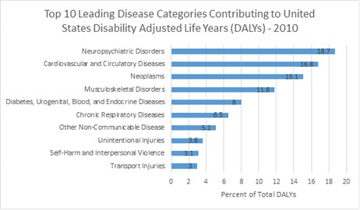
UN. World’s largest minority population: Persons with disabilities
Most prevalent in US: Neuropsychiatric disorders
https://www.americanbraincoalition.org/page/PPPHelpPatients
https://www.un.org/development/desa/disabilities/resources/factsheet-on-persons-with-disabilities.html

Slide 4
Alzheimer’s and the Brain Outline/Learning Objectives. Describe:
Successful Aging and the dementias
MIND prevention diet
Multidomain lifestyle prevention approaches
Positive behavioral controls for challenging behaviors

Slide 5
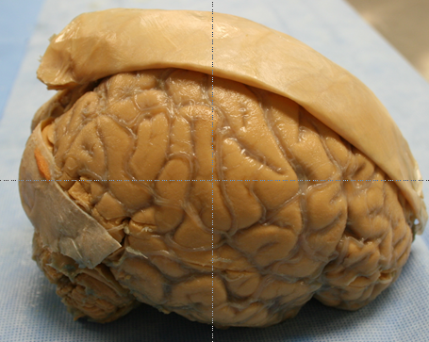
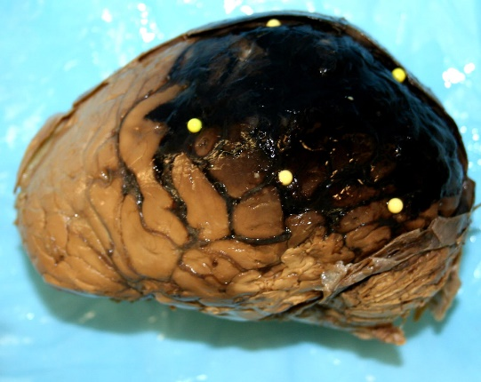
“The Universe Between Our Ears”
Brain: The Last Great Frontier of Science*
Alzheimer’s
Aravich
Aravich
Behavioral Neuroscience: The Last Frontier of the Last Frontier of Science
Fatal TBI
Hubble Telescope http://pics-about-space.com/hubble-andromeda-galaxy-pictures?p=1
Andromeda Galaxy (M31): 2.6 M light years ~15 Billion- Billion miles away. Visible by unaided eye
*See Aravich, TEDx on the You Tube Channel https://www.youtube.com/watch?v=-SfJsqnMRVc on

Slide 6
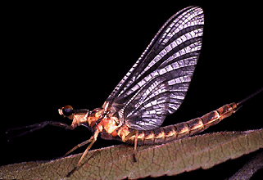
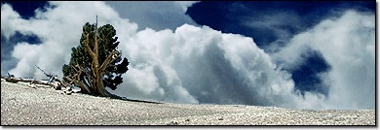
Fact. Successful aging:
A goal of all God’s creatures
http://phylogeny.arizona.edu/tree/eukaryotes/animals/
arthropoda/hexapoda/ephemeroptera/ephemeroptera.html
Mayfly: 1 day
For people w/o disabilities.
For people w/ disabilities
Bristlecone pine tree: 4,000 years
http://www.sonic.net/bristlecone/Images2.html

Slide 7
Fact. Successful aging is a brain thing
More than avoidance disease/disability
Successful aging is defined as:
High physical function
High cognitive function
Engaged in social/productive activities
Rowe/Kahn Gerontologist 1997 37:433-440

Slide 8
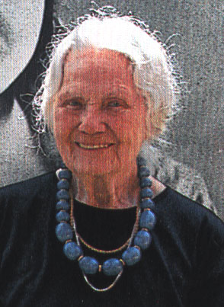
Fay Gillis Wells female aviator with Amelia Earhart in 1929
Key to successful aging?
Pursue “the completely unexpected opportunities that come along in life.”
“Be happy, have fun”
“Happy landings, and beautiful trees”
10/29/02 email to Paul Aravich
Co-Founder of the International Forest of Friendship to honor aviation’s greats; near the birthplace of Amelia Earhart http://www.ninety-nines.org/FOF3.html
Photo Age: 90
Died: 94
Morell/Leen Natl Geographic 1998 Jan. p. 131

Slide 9
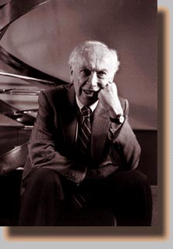
James Watson. “We found the key to life” in 1953 PBS 1/27/04
DNA vs the Biopsychosocial model
Who really found the secret
Watson or Fay Wells? Pursue the unexpected opportunities
http://www.main.com/~gj/physics/cheri/watson.gif

Slide 10
Fact. We fear senescence not aging
Aging is the passage of time
Normal, developmental changes over time
Infancy, childhood, puberty, adult, older adult etc.
Senescence is a programed ↓ in fitness & ability to fight death
Eventually leading to death
Williams. Q Rev Biol 74(4):405-415, 1999. Merck Manual of Geriatrics 2006
Due to, e.g.: oxidative stress, inflammation, apoptosis
We fear senescence not aging
Aging is Not a disease though Silicon Valley says it is
http://longevityalliance.org/?q=how-silicon-valley-trying-cure-ageing
Monaco & Silveira. Aging is not senescence… Clinics (Sao Paulo). 2009 May;64(5):451-7. http://www.ncbi.nlm.nih.gov/pmc/articles/PMC2694250/ And http://jcb.rupress.org/content/early/2017/11/06/jcb.201708092

Slide 11
Defense against senescence: The Senescence Buffer Zone
3 Goal of Successful Aging: Strengthen the buffer zone (“moat”), stop the Visigoth senescence attack
“Brain fitness:” Nutrition, exercise, social determinants
Senescence pathology
Roman Castle (brain etc.)
Protective buffer (like a moat)
2 Buffer zone protects against senescence “Visigoths,” but shrinks w/ aging
1 Visigoth senescence attack: oxidative stress, inflammatory cytokines etc.
Rattan. Aging Dis. 2014 Jun 1;5(3):196-202 http://www.ncbi.nlm.nih.gov/pmc/articles/PMC4037311/#!po=9.37500
Castle http://www.exploring-castles.com/medieval_castle_layout.html#.U8Z2AoVSn3w
Visigoths http://visigoth-project.wikispaces.com/Visigoth+Warriors

Slide 12
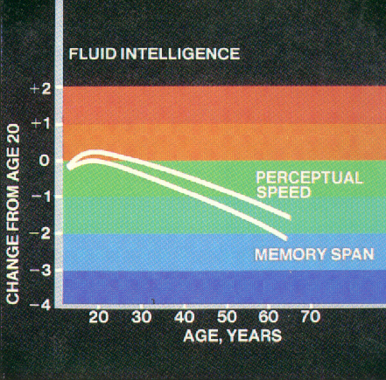
Fact. Age-Related Cognitive Decline is normal, Mild Cognitive Impairment is not
FYI: accelerated w/:
APOE4 cholesterol transport protein allele
an Alzheimer’s risk factor
Mild Cognitive Impairment:
Worse than age-related
Noticeable but does not affect daily living
An Alzheimer’s Risk factor
Normal Age-related cognitive decline
Brain in Aging & Dementia. Clin. Ctr., US Public Health Serv. p. 17

Slide 13
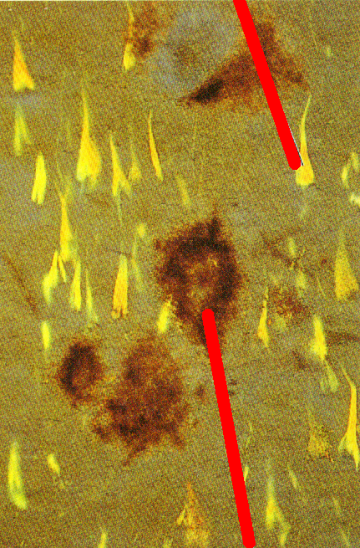
Fact. Amyloid Plaques & Neurofibrillary Tangles: a normal feature of brain aging in, e.g., hipp. formation
Tangles: microtubules w/ hyperphosphorylated tau protein
Excess numbers in, e.g., precuneus of Alzheimer’s disease
Purves et al. Neuroscience. Sinauer, 1997 p. 560
Amyloid plaques: extra-cellular debris w/, e.g., amyloid-beta protein
https://www.ncbi.nlm.nih.gov/pmc/articles/PMC6182068/

Slide 14
All Cause Dementia: Dx Criteria
Everyday activities impaired
e.g., social activities, work, managing money, cook/shop
Cognitive/Behav Impairment: >2 of following 5 domains
Recent memory note memory does Not have to be affected
Language speaking; reading; writing
Judgment/reasoning place an iron in refrigerator
Visuospatial function driving problems; clock draw
Personality/behavior changes apathy, withdrawal, agitation
Impairments have declined from previous levels
Not due to delirium temporary & sudden (hrs/days) confusion/fluctuation of awareness b/c of infections, drugs, etc.
Not due to mental illnesses like depression
Not due to other causes like thyroid etc.
McKhann et al., 2011 https://www.alz.org/documents_custom/Diagnostic_Recommendations_Alz_proof.pdf

Slide 15
AD clinical guidelines: Dx Probable Alzheimer’s
Meets general criteria for all-cause dementia
Rule out other causes of cognitive impairment, e.g.
Thyroid problems
Vitamin B12 deficiency
Lesions/tumors/bleeds/ via standard MRI ¹ including vascular cause
Gradual onset and Slow progression
Deficits in 3 specific domains:
recent memory, visuospatial, judgement/reasoning; and
At least 1 other domain
e.g., language like naming (anomia), reading (alexia;) or personality
McKhann et al., 2011 https://www.alz.org/documents_custom/Diagnostic_Recommendations_Alz_proof.pdf
http://www.ncbi.nlm.nih.gov/pubmed/21729419

Slide 16
Fact. The 3D’s Impair cognition & can be confused
Dementia
Delirium
Depression
Rule of thumb: need experts to render diagnosis
like geriatricians, geriatric psychiatrists, neurologists etc. with specialized dementia training

Slide 17
Dementia types: 4 Reversible if diagnosed/treated/cured
Drug induced polypharmacy: PRIMARY REVERSIBLE CAUSE
Vitamin B12 deficiency
FYI. Chronic antacids, Pernicious anemia, Gastric bypass surgery, metformin for diabetes, lot’s of other meds, strict vegans w/o B12 supplements, etc.
Malnutrition, e.g.,
Protein-Energy Malnutrition starvation/cancer/other diseases
Thiamine (B1) deficiency due to alcohol causing Korsakoff’ s dementia
Thyroid related
Infections (e.g., meningitis, untreated syphilis)
Liver/kidney failure
Heavy metals like lead, mercury
Normal pressure hydrocephalus

Slide 18
Irreversible dementia deaths vs selected others
Dementia All-Cause 261,914 (1, 2017) #3 cause death
#1 2017 Heart diseases: 647,457. #2 Cancer: 599,108
https://www.cdc.gov/nchs/data/dvs/lcwk/lcwk1_hr_2017-a.pdf
Alcohol: ~95,000 (2, 2015)
All drug overdoses ~71,000 (3, 2019)
Opioids alone or w/others ~49,000 (3, 2019)
Suicide: ~48,000 (4, 2019)
Homicide ~19,000 (5, 2018)

Slide 19
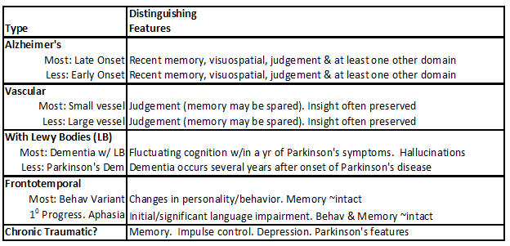
Fact. Many irreversible dementias, e.g.
Note: most dementias are mixed
Importance of preventative strategies for each
Aravich PF. Summary taken from various published articles

Slide 20
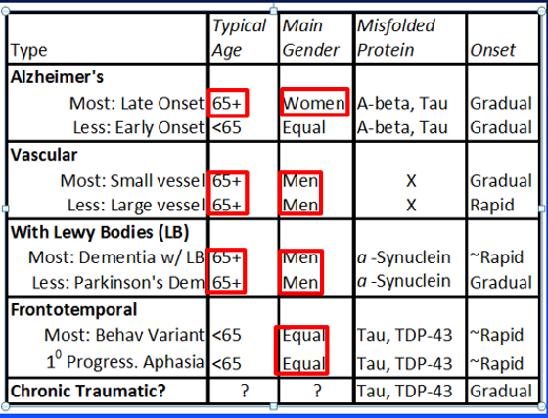
Irreversible dementia features, e.g.
Protein Misfolding Hypothesis: Characterizes Several dementias
Aravich. EVMS

Slide 21
Irreversible dementia deaths vs selected others
Dementia All-Cause 261,914 (1, 2017) #3 cause death
#1 2017 Heart diseases: 647,457. #2 Cancer: 599,108
https://www.cdc.gov/nchs/data/dvs/lcwk/lcwk1_hr_2017-a.pdf
Alcohol: ~95,000 (2, 2015)
All drug overdoses ~71,000 (3, 2019)
Opioids alone or w/others ~49,000 (3, 2019)
Suicide: ~48,000 (4, 2019)
Homicide ~19,000 (5, 2018)

Slide 22
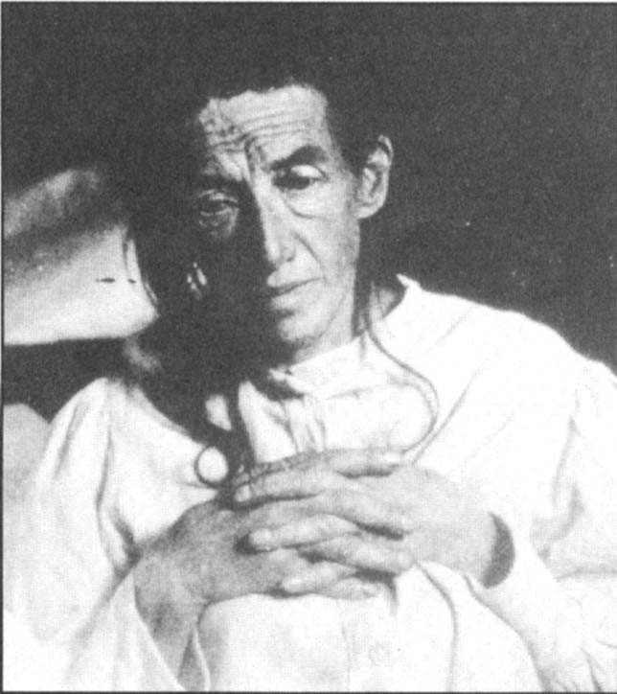
first pt diagnosed with Alzheimer’s 51 y/o female: Auguste D. Photo: 1902. Early onset AD Case presented to 37th Meeting, Southwest German Psychiatrists, Tübingen, 11/03/1906. Called AD in 1910.
Fiction. We will all get Alzheimer’s
”the first 100 years”
Alzheimer’s Association News Letter 1997
Max Planck Inst. http://www.mpg.de/news98/alzheim.htm

Slide 23
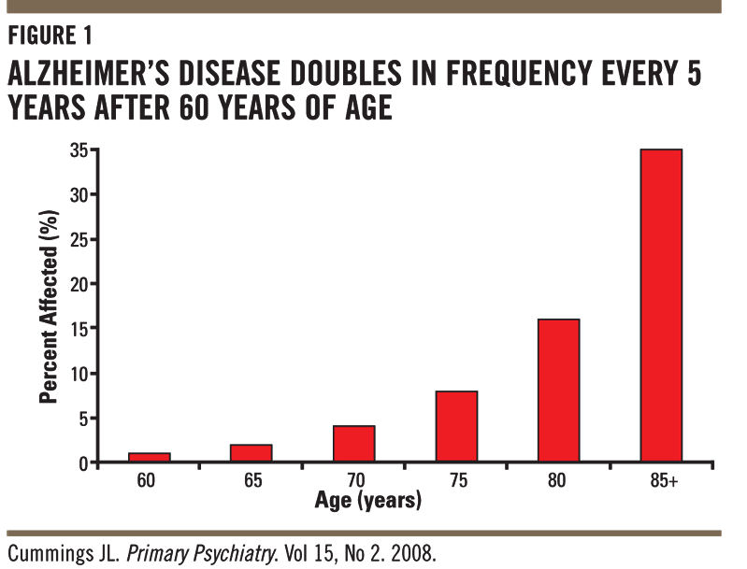
AD and the Old-Old 85+
~35% in “Old-Old = 85+
~8% 75 yo
~2%

Slide 24
Prevalence of all Dementias (USA)
71-79 yo: 5.0%¹
>90: 37.4%¹
Nursing homes: 58.0%²
Fact: we fear Alzheimer’s disease (AD) more than death itself
die in the fetal position
Kevorkian's 1st assisted suicide pt:
Dx w/ early Alzheimer’s
1Plassman et al. Neuroepidemiology 2007;29:125-132 2Seitz et al. Int Psychogeriatr. 2010 Nov;22(7):1025-39

Slide 25
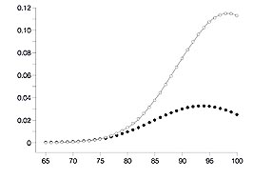
Alzheimer’s: A woman’s health issue women & men with > 13 years education & no ApoE4. APOE4 is a CHL transport protein allele linked to increased AD and heart disease risk
women
↑ women vs men when 80+ y.o. HR 2.11 (95% CI, 1.22-3.86)
Discrete Annual Hazard Ratio
Modified from Fig. 2A. Zandi et al. JAMA. 2002 Nov 6;288(17):2123-9. Cache County Study
Similar gender risks until ~80 y.o.
men
Age
Older view: More women AD b/c live longer? Emerging view: a woman’s health issue

Slide 26
Fact. Alzheimer’s: a Woman’s Health Issue
Women: More likely to have it.
Women: Majority of care givers
Family caregivers and
Professional Caregivers like certified nurse assistants (CNAs)
Who takes care of the caregiver?
Promotion of mental wellness: take “Mental Health First Aid”
Challenging behaviors by care recipient:
More training on positive behavioral controls and crisis intervention. Soon to be announced Aravich CDC grant
Google ARDX Foundation. Online: Shining a Light on Women Living with Dementia. Aravich et al. 10-noon, 10/27/22

Slide 27
Fact. Alzheimer’s is a Minority Health issue
2x’s worse rate in Black Americans
1.5x’s worse rate in Hispanics
Major outreach initiative of Alzheimer’s Association

Slide 28
Fact
https://www.kff.org/racial-equity-and-health-policy/issue-brief/beyond-health-care-the-role-of-social-determinants-in-promoting-health-and-health-equity/

Slide 29
CCC+ Commonwealth Coordinated Care Plus
Part of Virginia Medicaid Expansion Program
Evidence-based Person-Centered Medical Home
For persons with complicated behavioral and physical needs
General lack of clinician awareness
https://www.dmas.virginia.gov/for-members/managed-care-programs/ccc-plus/
https://www.cccplusva.com/

Slide 30
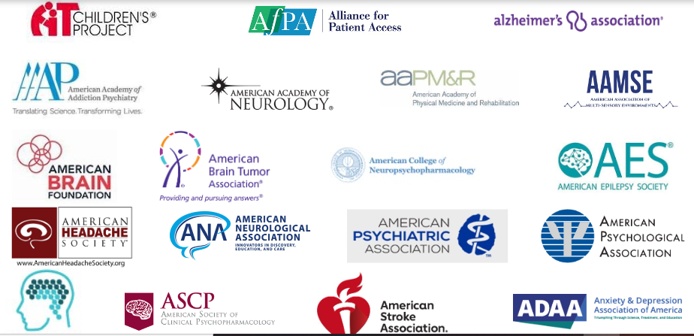
Fact. Silos: Asset Mapping, Champions, Coalitions
“If you want to go fast, go alone. If you want to go far, go together” African proverb
e.g. The American Brain Coalition
NAMI
Depression/Bipolar Support Alliance
Parkinson’s Fdn
Society for Neuroscience etc.
https://www.americanbraincoalition.org/page/NonProfitMembers

Slide 31
The National Imperative to Improve Nursing Home Quality: Honoring Our Commitment to Residents, Families, and Staff. National Academies. April 2022. https://www.nationalacademies.org/our-work/the-quality-of-care-in-nursing-homes
Fact. Upwards of half of nursing homes residents have dementia. Sadly they US nursing homes are failing
“The way in which the United States finances, delivers, and regulates care in nursing home settings is ineffective, inefficient, fragmented, and unsustainable…”
https://www.nationalacademies.org/news/2022/04/wide-ranging-systemic-changes-needed-to-transform-nursing-homes-to-meet-needs-of-residents-families-and-staff

Slide 32
Work Group. DBHDS Immediate Recommendations
Dementia behavioral specialists, Dept Behav Health Dev Serv:
Linked w/ Alz. Assoc., Area Agencies on Aging; Health Depts. etc.
Case management/transitions of care.
Integrated w/ CSB interdisciplinary teams.
Partner/coordinate with mobile crisis teams
Outcome data
Collaborate w/ existing organizations, e.g.:
Alzheimer’s Chapters, VCU Center on Aging, EVMS, Health Depts.
Workforce development/training
VDH ECHO (Extension for Community Healthcare Outcomes)
Targeted investments: Outreach/awareness/training, e.g.
Area Agencies on Aging: “Dementia Navigators”
Caregivers; first responders
Crisis Intervention Team Training; Mental Health First Aid
Funding, e.g., CDC “BOLD Infrastructure for Alzheimer’s Act”

Slide 33
VDS Work Group. DBHDS, cont. Immediate Recommendations
Pilot Respite Care and Crisis Care programs, e.g.,
Specialized crisis stabilization units, dementia/brain injury
More resources to Dept. Aging & Rehab Services to, e.g.,
Eliminate Silos; promote state/private collaboration
Asset-mapping of existing resources/champions.
Statewide Northern Va. RAFT-type programs: Regional Older Adults Facility Mental Health Support Team
Long-term supports
Data: ↓ State Psychiatric hospital admits
Builds on existing community resources
24/7 Safety net

Slide 34
VDS Work Group. DBHDS, cont. Future Areas of Focus
Dept Aging Rehab Services: Leads future initiatives
Pipeline programs---including K-12---for Work Force devel.
Improved training, e.g., Virginia Medical Reserve Corps during pandemics and disasters
Freely available online training for the public, e.g.:
Dementia care best practices
National effort to ↓ antipsychotics for challenging behav.
CCC+: Virginia Medicaid Exp. program for persons w/ complex behavioral and medical needs
Other, e.g.
Geriatric “Club House Models” from SMI/TBI best-practice respite care
Expansion of PACE eligibility Program of All Inclusive Care for the Elderly
Reconsider use of dementia as a mental illness for TDO’s
Not discussed: Geriatric “Culture Change” movement to de-institutionalize/transform community/LTCF care in a person-directed way
e.g., Green House model. Pioneer network

Slide 35
Specialized Care Pilot Program
Western Tidewater Community Services Board, Region 5 DBHDS.
Specialized challenging behavior tx programs: One for the dementias; another for BI
Regional Coalition, WTCSB Demetrios Peratsakis, includes:
SE Va. AD Chapter, Brain Injury Association of Virginia, EVMS Glennan Center Geriatrics/Gerontology, various statewide leaders

Slide 36
Fact. There are multiple Stages of Late-Onset Alzheimer’s Disease (AD) modified from NIA 2011Fa
Preclinical. Decades. No symptoms
Mild Cog. Impairment due to AD
Mild Alzheimer’s Disease
Moderate Alzheimer’s Disease
Severe Alzheimer’s Disease
Importance of prevention
Early Stage Alzheimer’s*
Alzheimer’s disease
*Not the less common “Early Onset AD,” which is clearly genetically transmitted and occurs in persons <65
https://www.dreamstime.com/stock-photo-rusty-abandoned-truck-yukon-used-construction-canol-road-canada-image86477777
The “rusty truck” analogy

Slide 37
. 2018;113(4):393-399
Theory: Seeds of Dementia Planted by adverse events in utero/childhood?
e.g. Origins of Alzheimer’s Across the Life Course (ORACLE) study, Lamballais et al. Eur J Epidemiol. 2021; 36(1): 117–127.
1st geriatricians: obstetricians
Advertisement, 1998 Kellogg Co., Time Magazine 1998 151(15), p. 23

Slide 38
.
Fact. Many Alzheimer’s Theories. Not mutually exclusive. Chicken vs egg?
https://www.ncbi.nlm.nih.gov/pmc/articles/PMC5676979/ https://www.nature.com/articles/s41392-019-0063-8
https://www.ncbi.nlm.nih.gov/pmc/articles/PMC3962811/ https://www.brightfocus.org/alzheimers/article/history-alzheimers-disease
Occom's Razor: tend towards simplest solution?
Chicken & the Egg problem?
Acetylcholinergic hypothesis 1970’s
Calcium signaling hypothesis 1980’s
Amyloid-beta cascade hypothesis (plaques), 1990’s-present
Tau hypothesis (tangles)
Neuron reserve hypothesis
Several Energetic/Metabolic hypotheses: Mitochondrial. Brain has “Type-3 diabetes.” Neuroenergetics
Neuroinflammation hypothesis
Oxidative stress hypothesis
Neurovascular: “cardioprotective is Alzheimer’s protective”
Epigenetic hypothesis multiple “hits” across the lifetime
Life style hypothesis

Slide 39
12 Modifiable Risk Factors for the dementias: ↓ Global burden by 40%. Lancet Commission, 2020
Problem Intervention (if possible)
Poor Nutrition MIND diet Mediterranean + DASH diet
Physical Inactivity More exercise, even if just a little
Less Education Cognitive stimulation
Low Social Contact “The human brain is a social brain”
Depression WHO #1 disabling cond. Earlier diagnosis/treatment
Traumatic brain injury #1 Environmental cause? Falls
Hearing impairment Better hearing assessments
Hypertension, Diabetes Benefit of the DASH diet
Air pollution, Smoking, Excess Alcohol
https://www.thelancet.com/article/S0140-6736(20)30367-6/fulltext
Add: COVID-19 Aravich
COVID-19 vaccination

Slide 40
Alzheimer’s and the Brain Outline/Learning Objectives. Describe:
Successful Aging and the dementias
MIND prevention diet
Multidomain lifestyle prevention approaches
Positive behavioral controls for challenging behaviors

Slide 41
MIND Diet (Mediterranean-DASH Intervention for Neurodegenerative Delay)
Morris et al. Alzheimers Dement. 2015 Sep;11(9):1015-22. Liu et al. Contemp Clin Trials. 2021 Mar;102:106270.
Elements of Mediterranean plus DASH diets
Differences from Mediterranean and DASH diets:
Emphasis on green leafy vegetables (spinach etc.)
No fruit increase except Increased berry intake
Also data suggesting overall benefits in Parkinson’s disease Metcalfe-Roach et al. Mov Disord. 2021 Apr;36(4):977-984

Slide 42
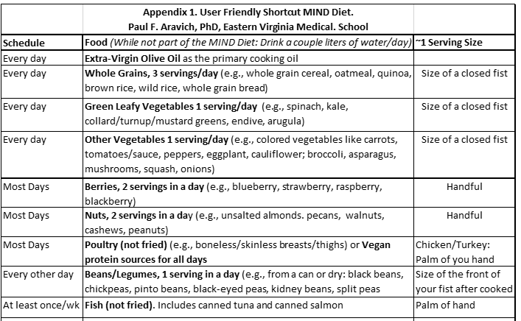
MIND Diet: selected elements
Also designed for weight loss. If weight loss is not desired, portion sizes can increase

Slide 43
CHD secondary prevention RCT Lyon Diet Heart study
4 yr vs a “prudent” Western diet
“Atypical” Mediterranean diet
no ↑ olive oil; canola oil instead
no ↑ red wine
no ↑ fish
↑ whole grain bread
↑ fruit
↑ poultry; ↓ red/processed meats
results
70% reduction in any cardiac event
better than any “statin”
What’s good for the heart is good for the brain.
Clinical Trial RCT needed on cognitive impact
see de Lorgeril et al. Circulation 1999 99(6):779-85

Slide 44
Alzheimer’s and the Brain Outline/Learning Objectives. Describe:
Successful Aging and the dementias
MIND prevention diet
Multidomain lifestyle prevention approaches
Positive behavioral controls for challenging behaviors

Slide 45
Lifestyle & Cognitive Decline: FINGER study Ngandu et al. A 2 year multidomain intervention of diet, exercise, cognitive training, social engagement and vascular risk monitoring versus control to prevent cognitive decline in at-risk elderly people (FINGER): a randomised controlled trial. Lancet. 2015 Jun 6;385(9984):2255-63
RCT: N=1260; 60-77 yo, sedentary, and @ risk for dementia (>6 out of 15 on the “Cardiovascular Risk Factors, Aging & Dementia Scale” CAIDE)
4 Behavioral Lifestyle Domains manipulated simultaneously (Along with cardiovascular monitoring. Control group: General health advice)
Nutrition: Similar to US Dietary Guidelines
Physical Exercise w/ physiotherapists & gym, e.g.:
-Mostly aerobic (e.g., 30 min moderate activity several days/wk)
-Some strength training (e.g., 2 days/wk focused on major muscle groups); & Balance
Cognitive exercise (w/a psychologist on aging; and online computer training)
Social stimulation: multiple group meetings
Results: ~25% better cognitive scores vs controls. Proof of Concept
Benefits occurred across various sociodemographic and cardiovascular risk factor conditions. Rosenberg et al. Alzheimers Dement. 2018 Mar;14(3):263-270.

Slide 46
Current US RCT: POINTER study (Protect Brain Health Through Lifestyle Intervention to Reduce Risk)
$20M grant from the Alzheimers and Related Dementias Association (AKA Alzheimer’s Association).
Subjects: aged 60-79 at risk for cognitive decline.
Like the FINGER study:
nutrition, physical exercise (mostly aerobic), cognitive exercise (in person and online) and social engagement (multiple group meetings) with cardiovascular risk factors monitored.
Unlike the original FINGER study:
Diet: MIND Diet
Online computer training: uses a platform called BrainHQ.
Participation requires proximity to the different study sites, none of which are in Virginia..

Slide 47
Other Physical Exercise?
Other Physical Exercise?
Moderate walking: “Diabetes Prevention Trial.” Walk 30 min/day 5-days/week and watch what you eat.
Gaelic saying. Poster at: https://www.pinterest.com/pin/227572587391691885/
Other Social Engagement?
Alzheimer’s Association, American Parkinson’s Disease Association, National Alliance for Mental Illness, Homeless shelters, Nursing home volunteers

Slide 48
Prevention: No more dementia “rusty trucks”

Slide 49
Alzheimer’s and the Brain Outline/Learning Objectives. Describe:
Successful Aging and the dementias
MIND prevention diet
Multidomain lifestyle prevention approaches
Positive behavioral controls for challenging behaviors

Slide 50
Positive behavioral control interventions
Watt et al. Ann Intern Med. 2019 Nov 5;171(9):633-642.
Non-Rx “…more efficacious than pharmacologic interventions for reducing aggression and agitation in adults with dementia.”
Fitzler, Raia, Wang. Am J Alzheimers Dis Other Demen. 2016 Dec;31(8):687-692.
ACA Innovation study, 30 NHs, 1 yr, interdisciplinary trial
Habilitation approach
Impressive clinical benefits
Sautter, Ord, Azher, Chidester, Aravich. Gerontol Geriatr Med. 2021 Feb 1;7:2333721421992996. Proof of concept: Computer engagement in advanced dementia.
Regional Coalition for Homeless Elders, Rebecca Brown.
Relates to the “H2” movement: Home = Health &, e.g. Supportive Public Housing and cognitive impairment

Slide 51
Fact on Challenging Behaviors Virginia Dementia Services (VDS) Work Group. DBHDS, 12/7/21 Convened by Virginia Sec. HHS Reported directly to Chairs, State Finance Com. and House Appropriations Committee https://rga.lis.virginia.gov/Published/2021/RD801/PDF Work Group Chair: Dr. Suzanne Mayo, Dir. Community Integration, DBHDS
State psychiatric facilities: Not suited to Tx challenging behaviors due to, e.g., the dementias
Less effective than specialized Tx facilities
More costly

Slide 52
New CDC funding Soon to be formally announced
Aravich, PI. Strike Teams and the COVID-19 LTC Facility Behavioral Health Crisis. CDC Nursing Home & Long-Term Care Facility Strike Team and Infrastructure Project
During pandemics and disasters
Mental wellness ambassador program for nursing home staffs
Positive behavioral control training for National Guard etc. strike team members
Free YouTube videos in partnership with VPM Richmond and the EVMS Standardized Pt. program
How Not to evacuate
https://www.npr.org/2020/12/24/947120581/the-tragedy-of-st-joes

Slide 53
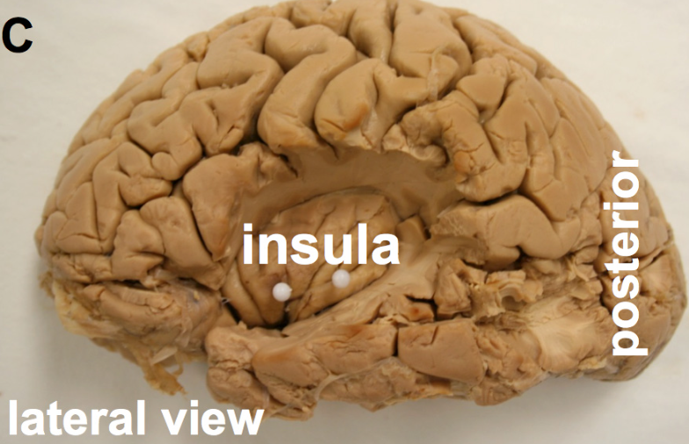
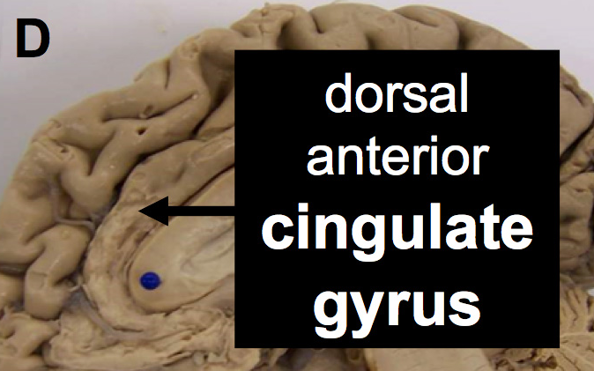
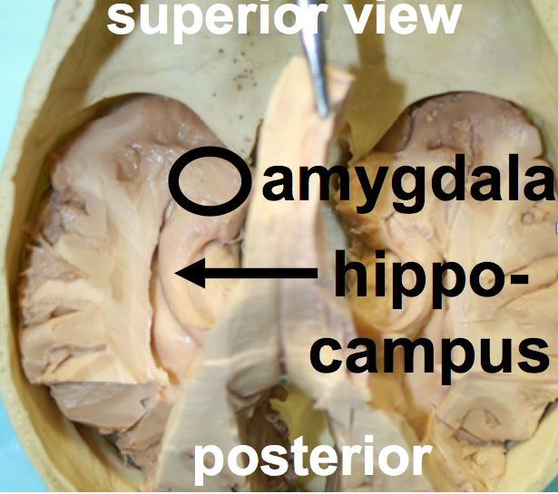
The Arts as positive behavioral controls
Aravich, Toboz, Roberts. 2016. https://vpm.org/articles/4907/the-arts-and-advanced-dementia
Maslow. Pinnacle of being human: Creative expression
e.g., “Art in the Making” Alzheimer’s Association Project
Arts and the Salience Neurocognitive Network (below):
Intact in advanced dementia
Can be fired by, e.g., Rx’s, TMS, behavioral therapy
And, can be fired by, e.g., familiar music
Photos from Aravich et al. above

Slide 54
Cognitive stimulation? How about familiar music: “Salience network” relatively spared in AD

Slide 55
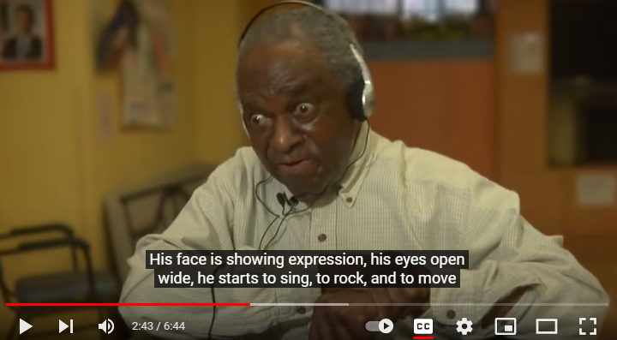
“Alive Inside” and the Salience Network Amygdala, Insula, ant. dorsal cingulate gyr. spared in late stage dementia see Aravich, Toboz MA, Roberts M & Arts. https://vpm.org/articles/4907/the-arts-and-advanced-dementia
Familiar religious music for a religious man w/ dementia
And how about those Legos?
https://www.youtube.com/watch?v=5FWn4JB2YLU
Feasibility but more research on music for challenging behaviors in dementia (1) and for music in TBI (2). 1) Sousa et al. Int J Geriatr Psychiat. 2021 Nov;36(11):1664-1690. Scoping Review. 2) Siponkoski et al. Neuropsychol Rehabil. 2022 Aug;32(7):1356-1388

Slide 56
Caregivers/recipients
Don’t forget the power of physical touch
And remember, “you see what you look for:”
Look for greatness in yourself
Look for greatness in persons with dementia
https://www.pinterest.co.uk/pin/171559067026042568/

Slide 57
Don’t forget Roslyn Carter
4 kinds of people
Those who
Were caregivers
Are caregivers
Will be caregivers and
Those who need a caregiver

Slide 58
Alzheimer’s and the Brain Outline/Learning Objectives. Describe:
Successful Aging and the dementias
MIND prevention diet
Multidomain lifestyle prevention approaches
Positive behavioral controls for challenging behaviors

